Slide 1


严谨 / 勤奋 / 求实 / 创新
严谨 / 勤奋 / 求实 / 创新
AI Emotion Recognition: Innovative Applications in Diverse Scenarios
Speaker：徐天心
Shanghai University
SHANGHAI
UNIVERSITY
2025.02

Slide 2



严谨 / 勤奋 / 求实 / 创新
01
Project Background
02
Project Objectives and Challenges
CONTENTS
This section introduces the definition, application scenarios, and technical background of emotion recognition
Describe the goals and challenges of the project
03
Realization of the project
04
Project application and future prospects
a
上善若水 / 海纳百川 / 大道明德 / 学用济世
Demonstrate the role and function of the project
This paper discusses the future development direction and potential challenges of emotion recognition technology

Slide 3





严谨 / 勤奋 / 求实 / 创新
严谨 / 勤奋 / 求实 / 创新
上善若水 / 海纳百川 / 大道明德 / 学用济世
PART 01
Project Background
This section introduces the definition, application scenarios, and technical background of emotion recognition

Slide 4

严谨 / 勤奋 / 求实 / 创新
PART ONE
Project Background
Definition of Emotion Recognition:
Emotion recognition refers to the recognition and understanding of human emotional states by analyzing human facial expressions, voice, text, or physiological signals (such as heart rate, brain waves, etc.). Common categories of emotions include: happy, sad, angry, surprised, fearful, disgusted, etc。
Application scenarios of emotion recognition:
Human-computer interaction: Enables machines to better understand user emotions and provide a more natural interaction experience.
Mental health: Provide mental health monitoring and intervention by analyzing the user's emotional state.
Marketing: Analyze consumers' emotional responses to advertisements or products and optimize marketing strategies.
Education: Improve learning by identifying students' emotional states and adjusting teaching methods.
Security monitoring: Identify abnormal emotions in public places and prevent potential dangers.
上善若水 / 海纳百川 / 大道明德 / 学用济世

Slide 5


严谨 / 勤奋 / 求实 / 创新
Technical Significance
·Promoting the Development of Artificial Intelligence: Emotion recognition is an important research direction in the field of artificial intelligence, which can enhance machines' understanding of human emotions and advance human-computer interaction technology.
Social significance
·Improve human-computer interaction experience: Emotion recognition technology can enable machines to "understand" humans better and provide smarter and more humanized services. ·Promote mental health: Through emotion recognition technology, users' psychological problems can be detected in a timely manner and personalized mental health support can be provided. ·Improve social safety: Deploying emotion recognition systems in public places can quickly identify abnormal emotions and prevent potentially dangerous incidents.
Economic significance ·Optimize business decision-making: Emotion recognition technology can help companies analyze consumer sentiment, optimize product design and marketing strategies, and enhance market competitiveness. ·Reduce labor costs: In customer service, education, and other fields, emotion recognition technology can partially replace labor and reduce operating costs.
上善若水 / 海纳百川 / 大道明德 / 学用济世

Slide 6
严谨 / 勤奋 / 求实 / 创新
严谨 / 勤奋 / 求实 / 创新
上善若水 / 海纳百川 / 大道明德 / 学用济世
PART 02
Project Objectives and Challenges
Describe the goals and challenges of the project

Slide 7

严谨 / 勤奋 / 求实 / 创新
Project Objectives
Develop an efficient emotion recognition model: Based on deep learning technology, build a model that can accurately identify a variety of emotion states.
Support multimodal data input: Support for extracting emotional information from facial expressions.
Implement real-time sentiment analysis: Develop a real-time sentiment recognition system that can quickly respond to user input and output sentiment analysis results.
Provide visual analysis tools: display the emotion recognition results in the form of charts or reports for users to understand and use.
上善若水 / 海纳百川 / 大道明德 / 学用济世

Slide 8

严谨 / 勤奋 / 求实 / 创新
上善若水 / 海纳百川 / 大道明德 / 学用济世
· Data diversity: There are differences in the expression of emotions among people of different cultures, genders, and ages, and the model needs to have strong generalization ability.
· Real-time requirements: In real-time applications, models need to meet the requirements of low latency while ensuring accuracy.
· Privacy protection: Emotion recognition involves sensitive information of users, and it is necessary to ensure the security and privacy of data.
Project Challenges

Slide 9
严谨 / 勤奋 / 求实 / 创新
严谨 / 勤奋 / 求实 / 创新
上善若水 / 海纳百川 / 大道明德 / 学用济世
PART 03
Realization of the project
Demonstrate the role and function of the project

Slide 10
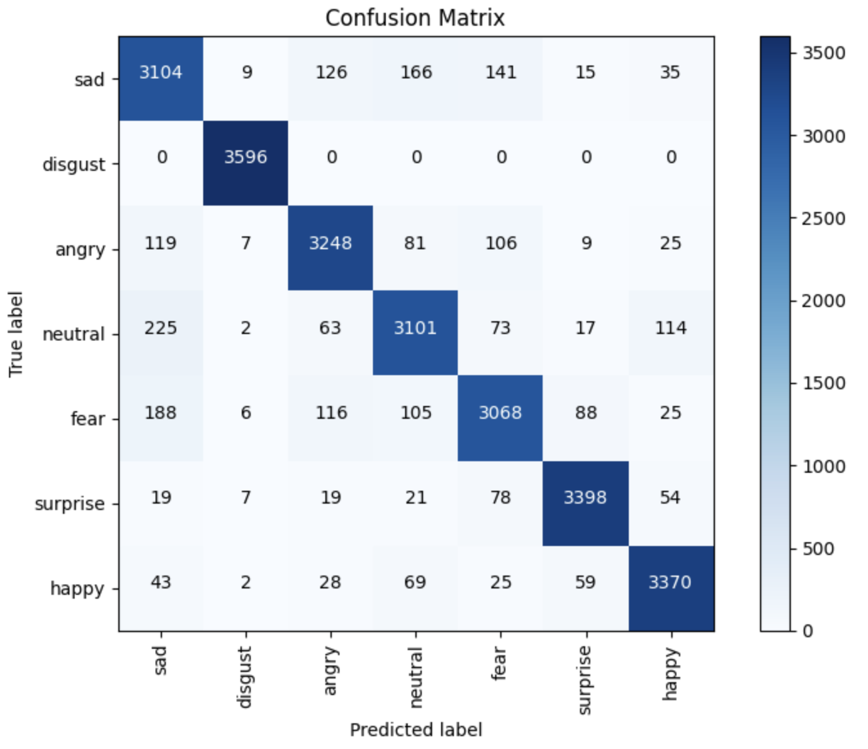
严谨 / 勤奋 / 求实 / 创新
Project Presentation
上善若水 / 海纳百川 / 大道明德 / 学用济世

Slide 11

严谨 / 勤奋 / 求实 / 创新
Enter title content
上善若水 / 海纳百川 / 大道明德 / 学用济世

Slide 12

严谨 / 勤奋 / 求实 / 创新
Enter title content
上善若水 / 海纳百川 / 大道明德 / 学用济世

Slide 13
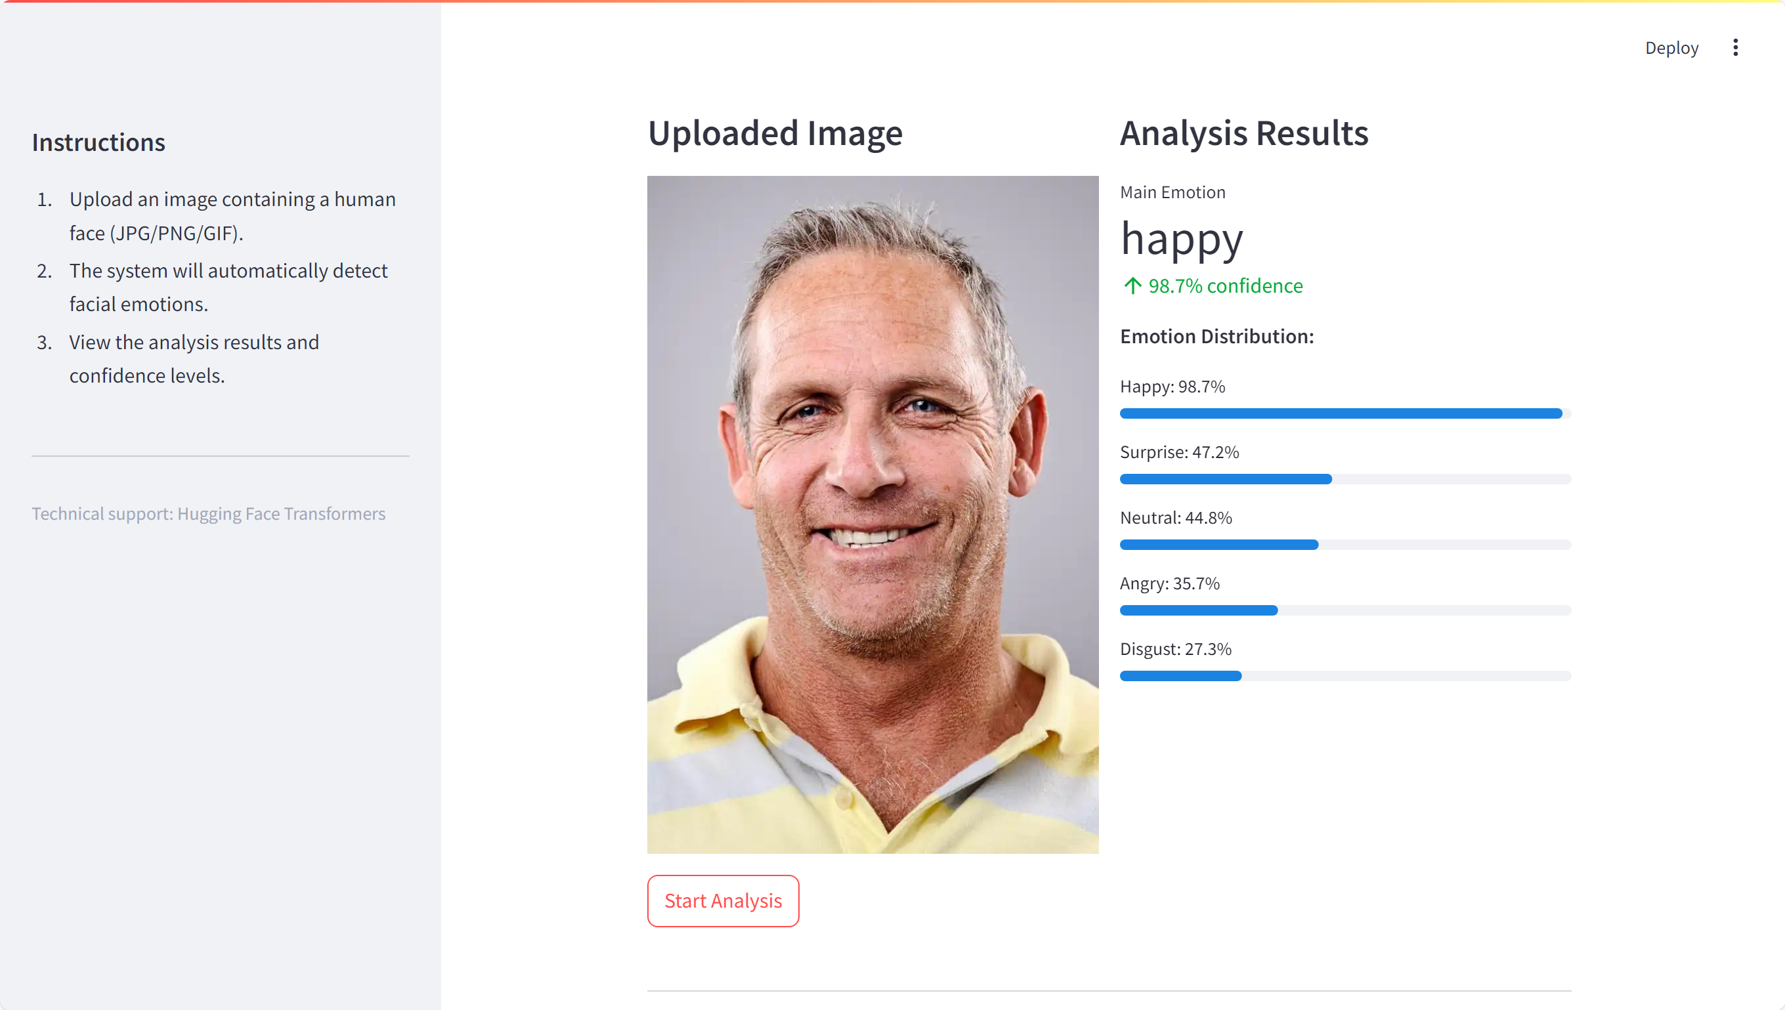
严谨 / 勤奋 / 求实 / 创新
Enter title content
上善若水 / 海纳百川 / 大道明德 / 学用济世

Slide 14
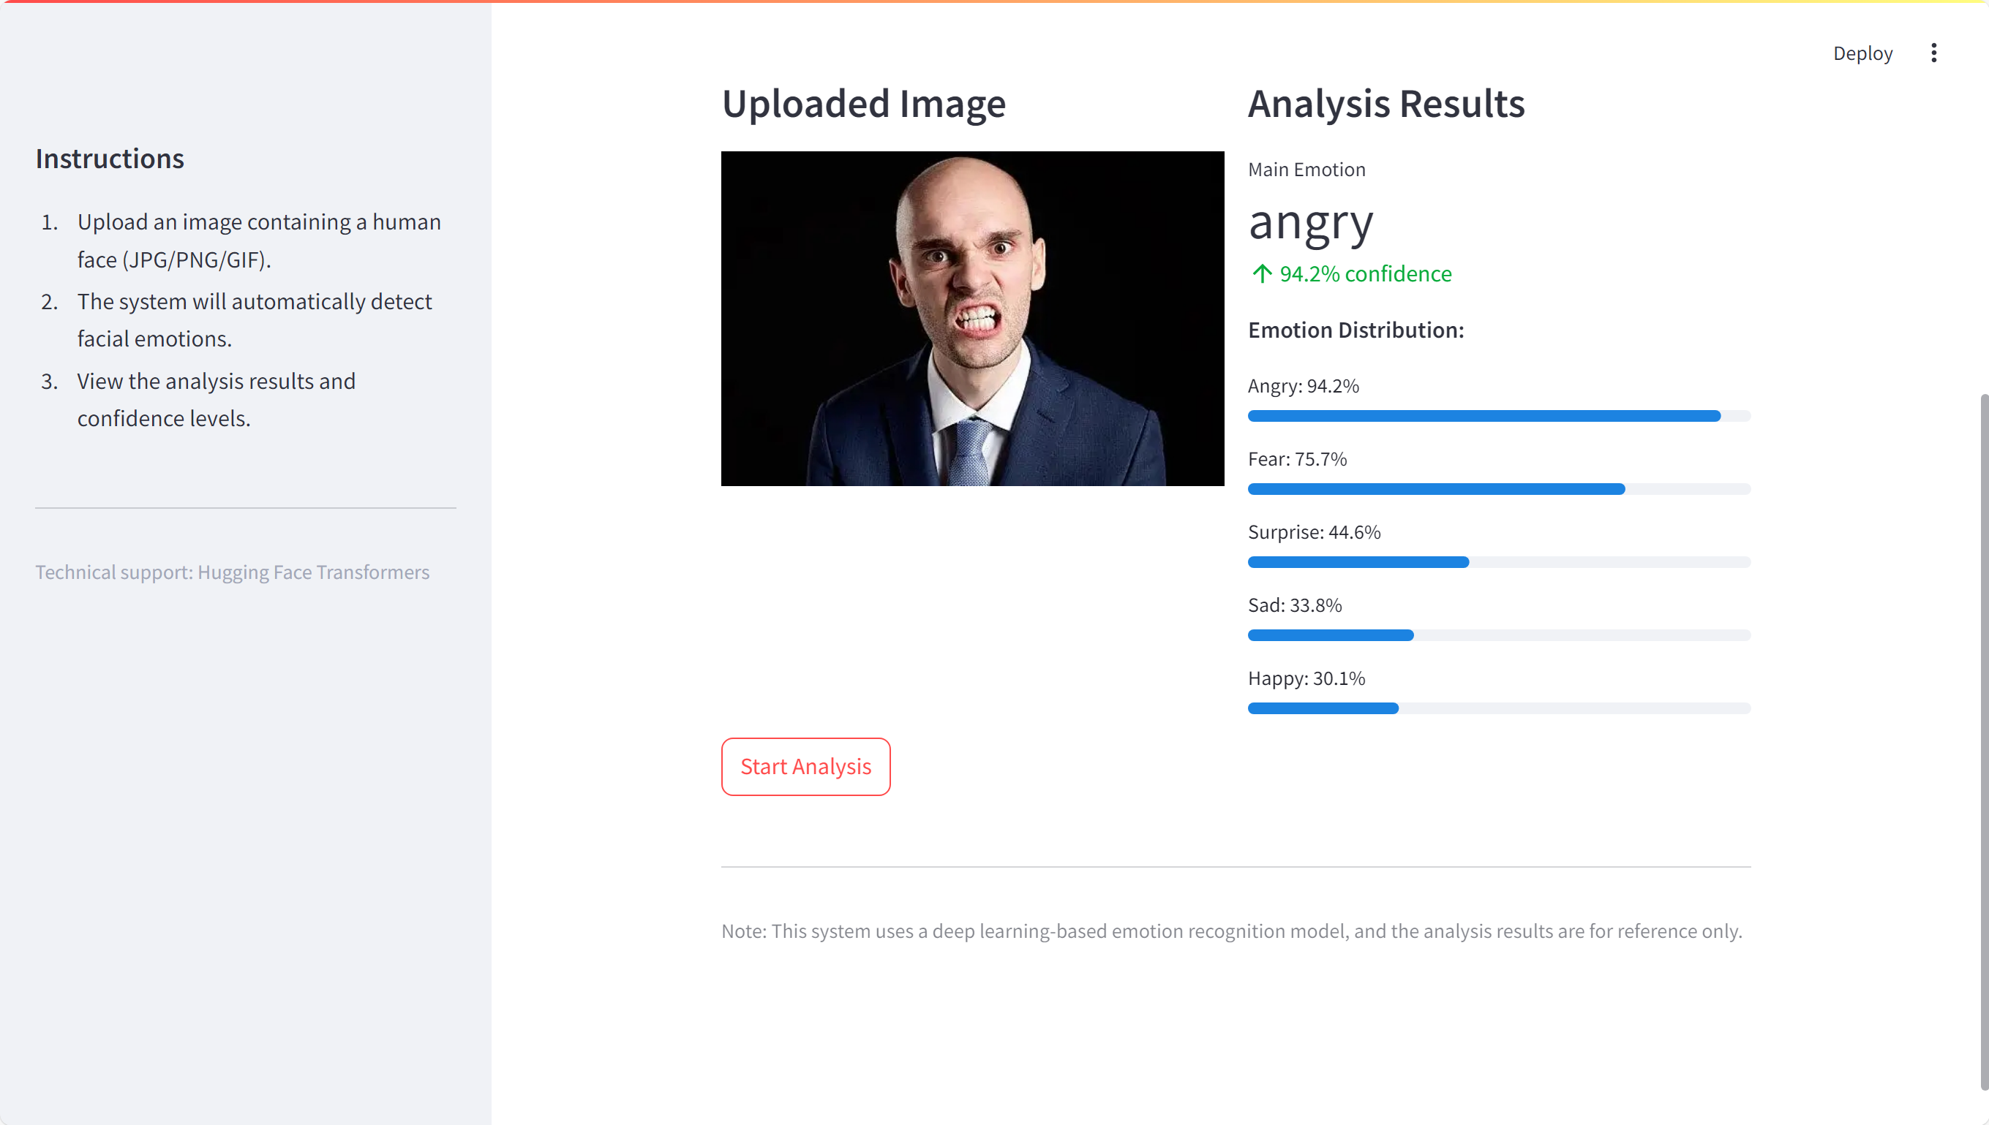
严谨 / 勤奋 / 求实 / 创新
Enter title content
上善若水 / 海纳百川 / 大道明德 / 学用济世

Slide 15

严谨 / 勤奋 / 求实 / 创新
Enter title content
上善若水 / 海纳百川 / 大道明德 / 学用济世

Slide 16
严谨 / 勤奋 / 求实 / 创新
严谨 / 勤奋 / 求实 / 创新
上善若水 / 海纳百川 / 大道明德 / 学用济世
PART 04
Project application and future prospects
This paper discusses the future development direction and potential challenges of emotion recognition technology

Slide 17
严谨 / 勤奋 / 求实 / 创新
严谨 / 勤奋 / 求实 / 创新
Mental health diagnosis
Project Prospects
By analyzing the patient's facial expressions, voice and text, doctors can assist in assessing mental health. For example, identify the emotional characteristics of patients with depression such as long-term sadness and depression, and timely remind further diagnosis and intervention.
Rehabilitation monitoring
Real-time monitoring of emotional changes in recovered patients to help therapists adjust their plans. For example, in physical rehabilitation, if the patient is anxious and depressed, the therapist can provide timely guidance to improve the compliance and effectiveness of treatment.
Aged care
Use cameras and wearable devices to collect emotional information about the elderly. Once negative emotions such as loneliness and anxiety are discovered, caregivers can care for them in time.
上善若水 / 海纳百川 / 大道明德 / 学用济世

Slide 18
严谨 / 勤奋 / 求实 / 创新
严谨 / 勤奋 / 求实 / 创新
Classroom effectiveness evaluation
Project Prospects
By analyzing students' classroom expressions and body language, teachers can grasp students' acceptance and interests of teaching content, and adjust teaching methods in a timely manner.
Advertising effectiveness evaluation
投放广告时，实时监测观众情绪反馈，分析表情、生理反应评估吸引力。若效果不佳，及时调整内容形式。
Film and television creation and production
In the process of creation, we grasp the emotional needs of the audience, analyze the emotional reactions to different works, and create and adjust the editing and soundtrack accordingly to enhance the appeal.
上善若水 / 海纳百川 / 大道明德 / 学用济世

Slide 19


严谨 / 勤奋 / 求实 / 创新
严谨 / 勤奋 / 求实 / 创新
Emotion recognition technology is an important research direction in the field of artificial intelligence, with a wide range of application prospects and social value. Through deep learning technology, we can build efficient and accurate emotion recognition models to provide strong support for human-computer interaction, mental health, marketing, and other fields.
Project Summary
上善若水 / 海纳百川 / 大道明德 / 学用济世

Slide 20

严谨 / 勤奋 / 求实 / 创新
严谨 / 勤奋 / 求实 / 创新
THANKS!
Shanghai University
SHANGHAI
UNIVERSITY
2024

